Slide 1

DSR Dashboard Data Analysis: A Case Study
This case study analyzes task planning and execution data from the DSR Dashboard, focusing on task performance, time management, and completion rates.
AA
by Aaditi Aaditi

Slide 2
Data Overview
Total Tasks
Unique Participants
Completion Rate
263 tasks were analyzed.
17 individuals contributed to the tasks.
66.54% of tasks were completed.

Slide 3

Task Distribution
Top 10 Participants
The tasks are distributed among 17 participants, with some managing significantly more tasks than others.

Slide 4
Time Analysis
Total Planned Time
Total Actual Time
Time Difference
13 days 23:25:00 was allocated for tasks.
Tasks took 13 days 09:35:00 to complete.
There was a net time difference of -1 days +10:10:00 between actual and planned times.

Slide 5
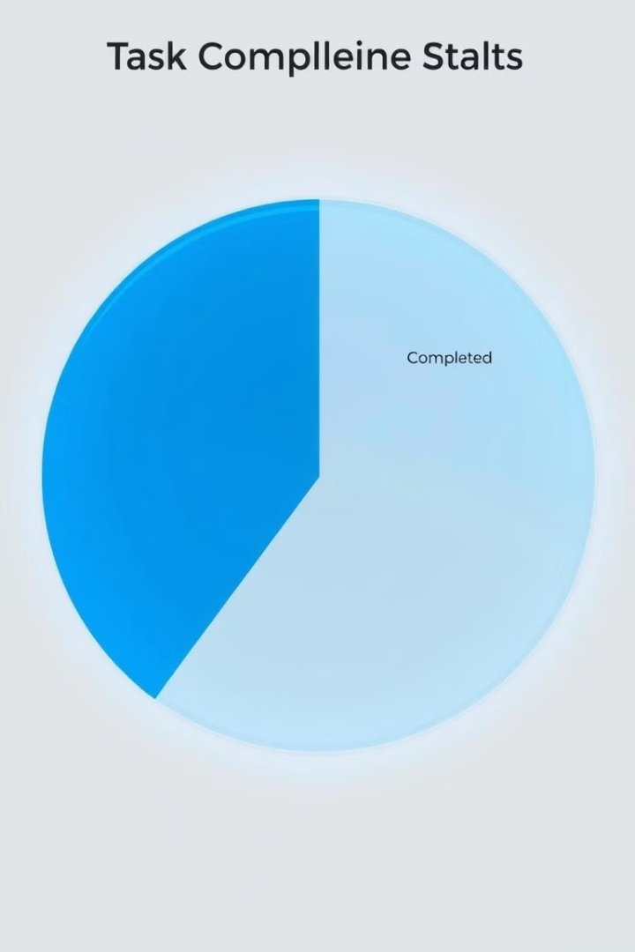
Task Completion Status
1
Completed
2
In Progress
66.54% of tasks were completed.
Some tasks are still in progress.
3
Not Started
A small percentage of tasks were not started.

Slide 6

Time Differences
Time Discrepancies
1
The histogram shows the distribution of time differences between planned and actual times.

Slide 7




Key Insights
High Completion Rate
Time Discrepancies
The completion rate is strong at 66.54%, indicating most planned tasks are completed successfully.
There is a net time difference of -1 days +10:10:00 between actual and planned times, highlighting potential inefficiencies.
Workload Imbalance
Tasks are distributed among 17 participants, with some managing significantly more tasks than others, potentially leading to workload imbalances.

Slide 8





Recommendations
Balance Workloads
Ensure equitable task assignments among participants.
Investigate Time Discrepancies
Identify reasons for discrepancies in planned vs. actual times to improve accuracy.
Provide Training
Offer training on time management and task estimation where necessary.
Implement Tracking Tools
Use tools to automatically track and compare planned vs. actual times, enabling quicker identification of performance gaps.

